Slide 1
Keeping Your Research Safe with Backups
Love Data Week 2020

Slide 2
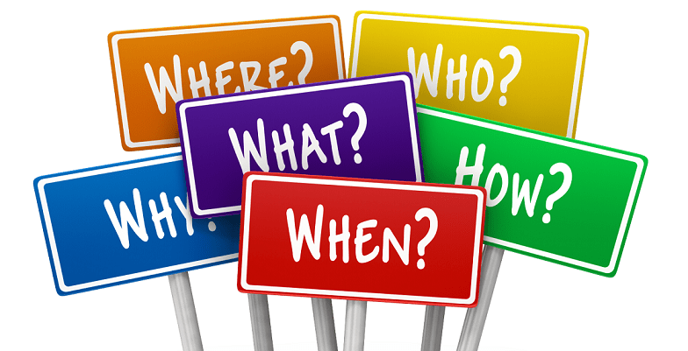

Slide 3
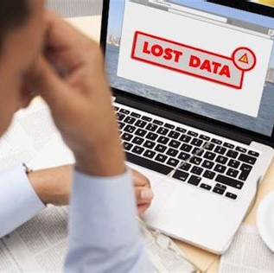

Why Should You Backup?
Data Loss Horror Stories
Data Loss Success Stories

Slide 4

Who Should Backup?

Slide 5
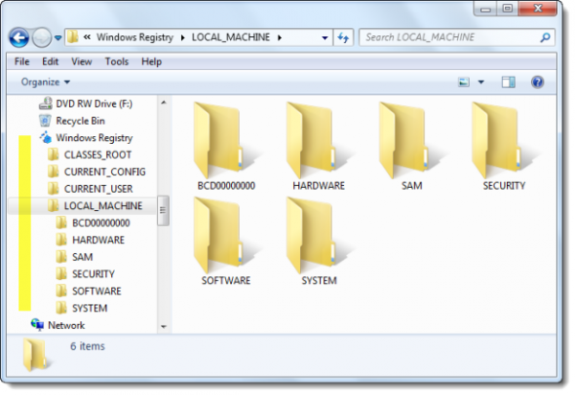
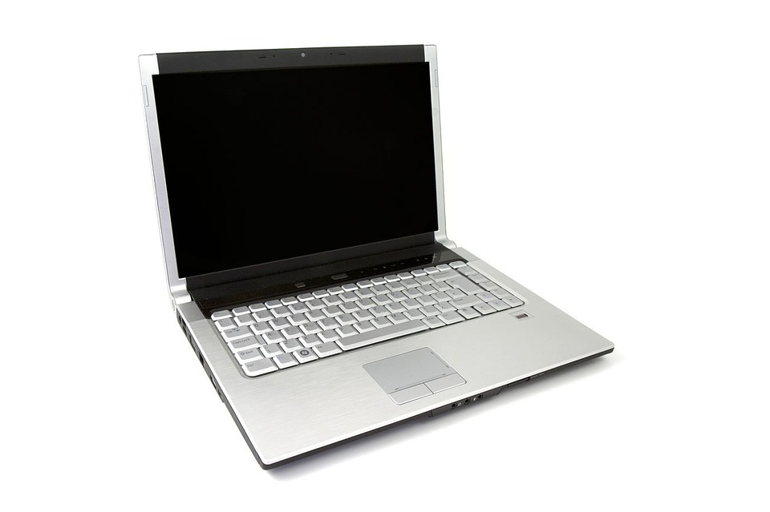
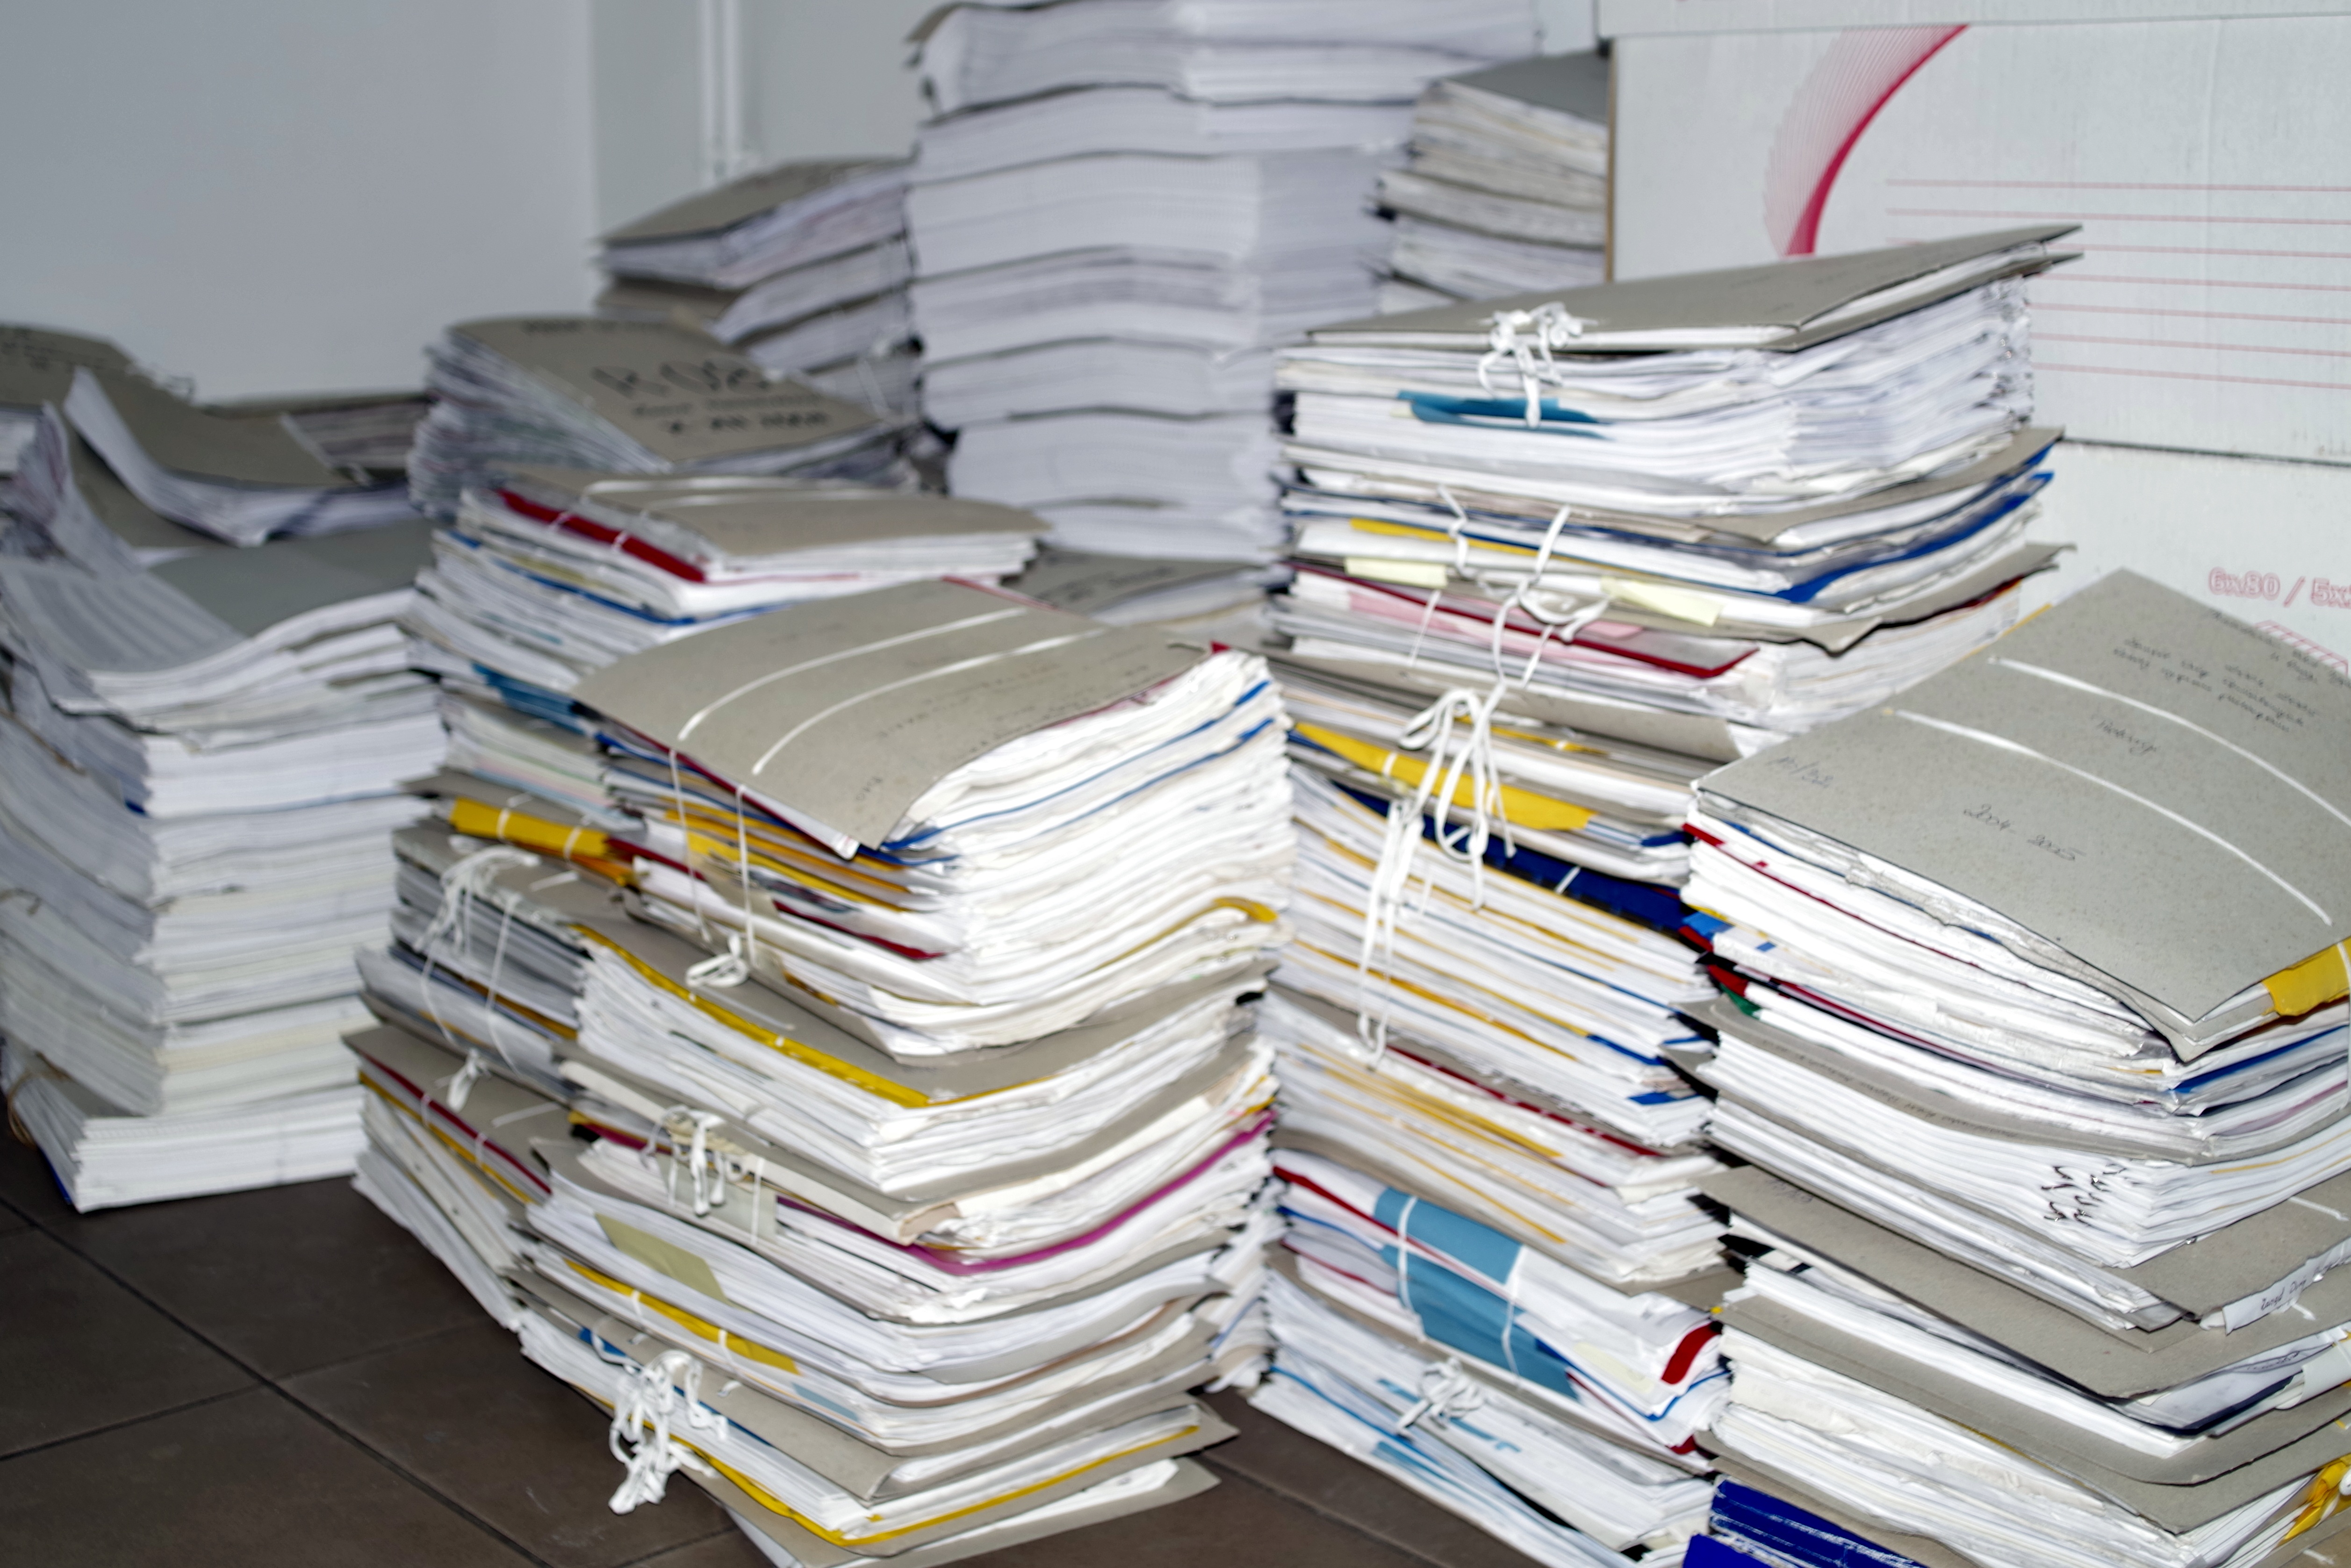
What Should You Backup?

Slide 6
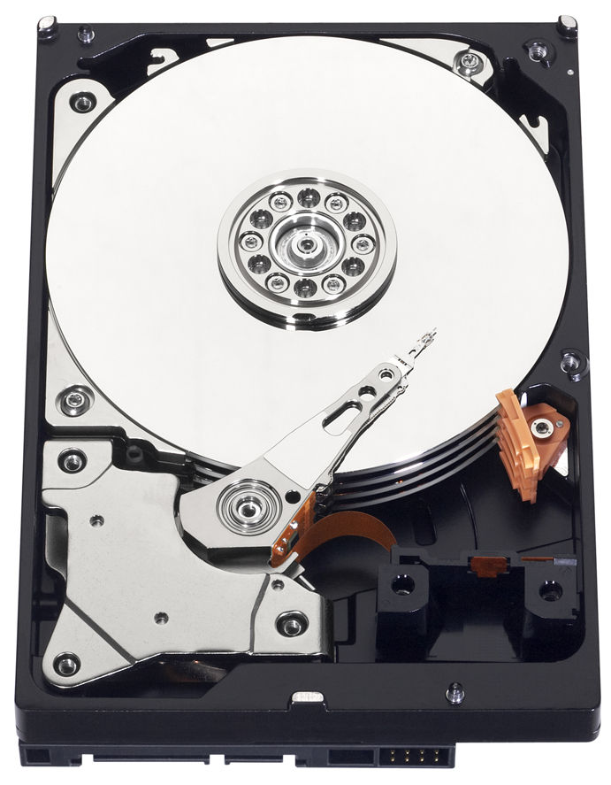
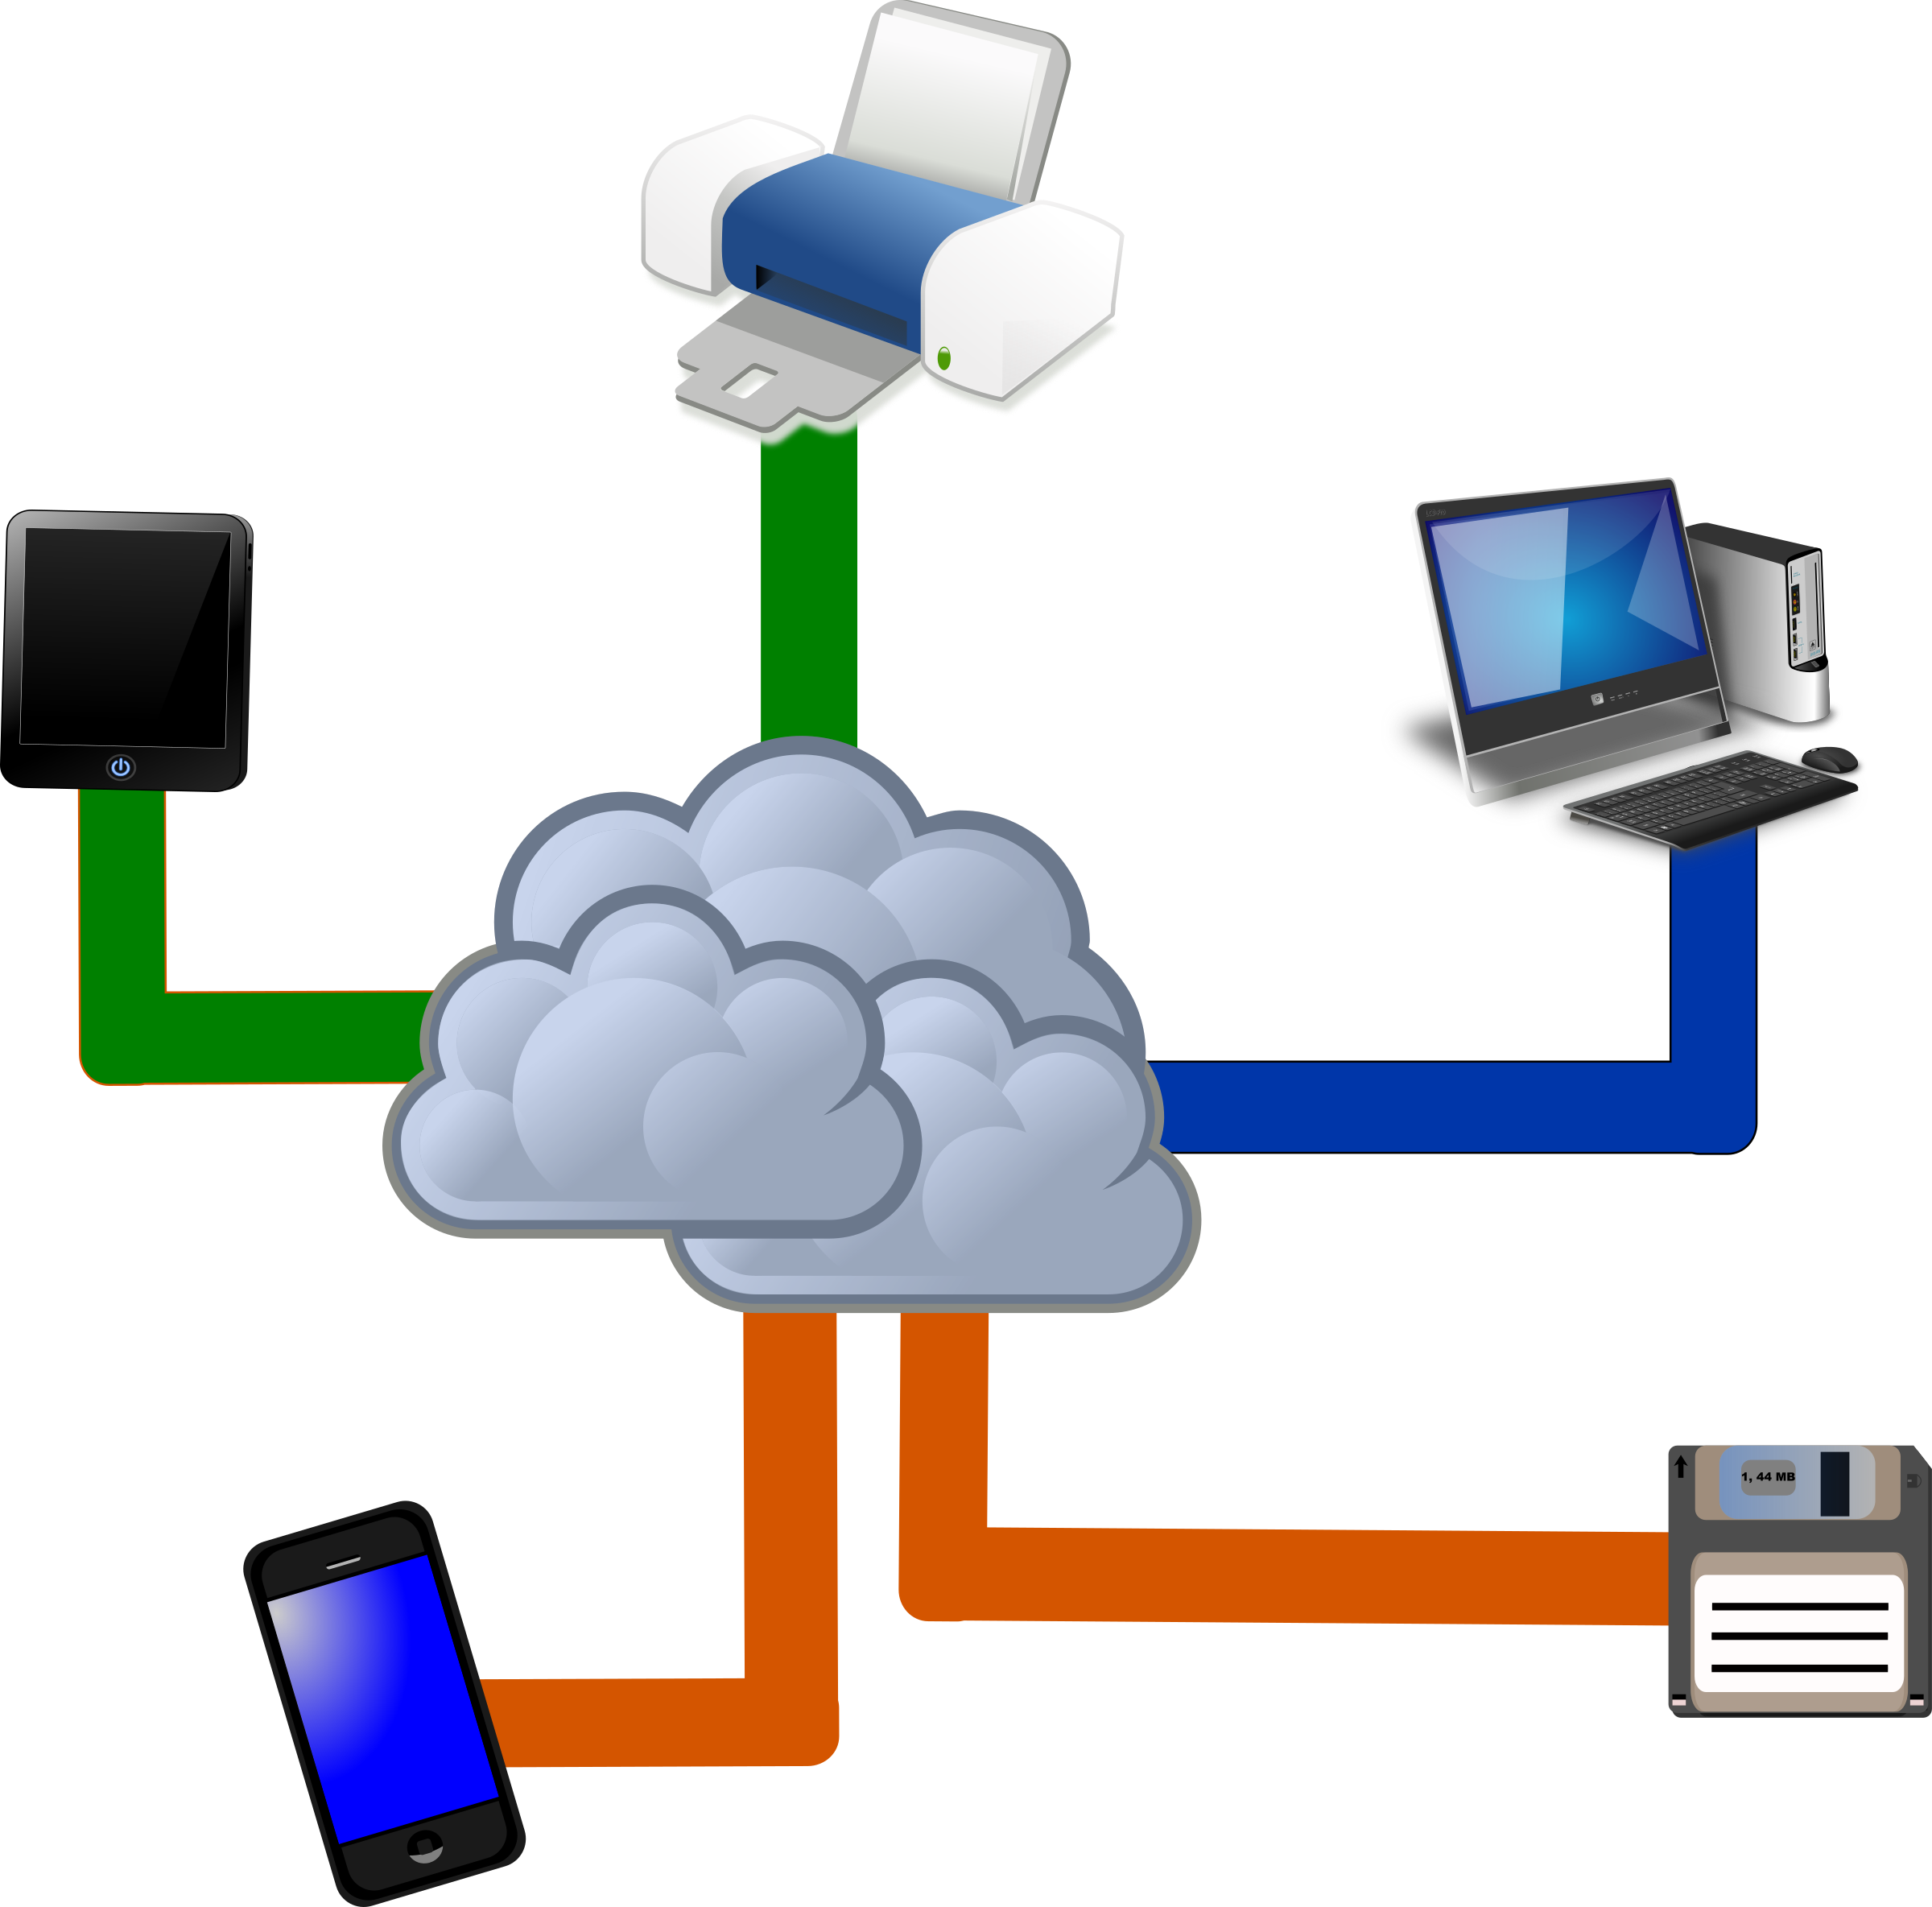
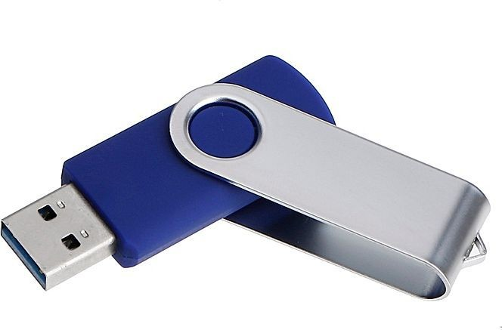
Where Should You Backup?

Slide 7
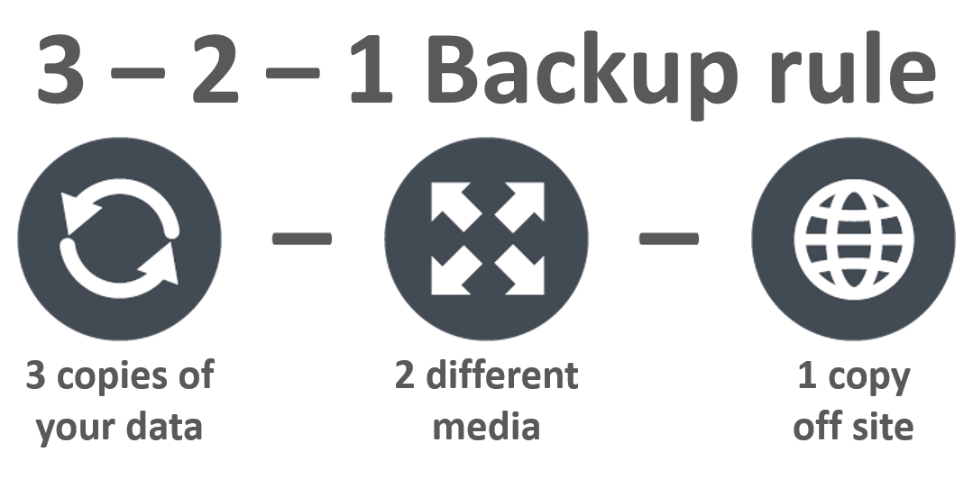
Where Should You Backup?

Slide 8
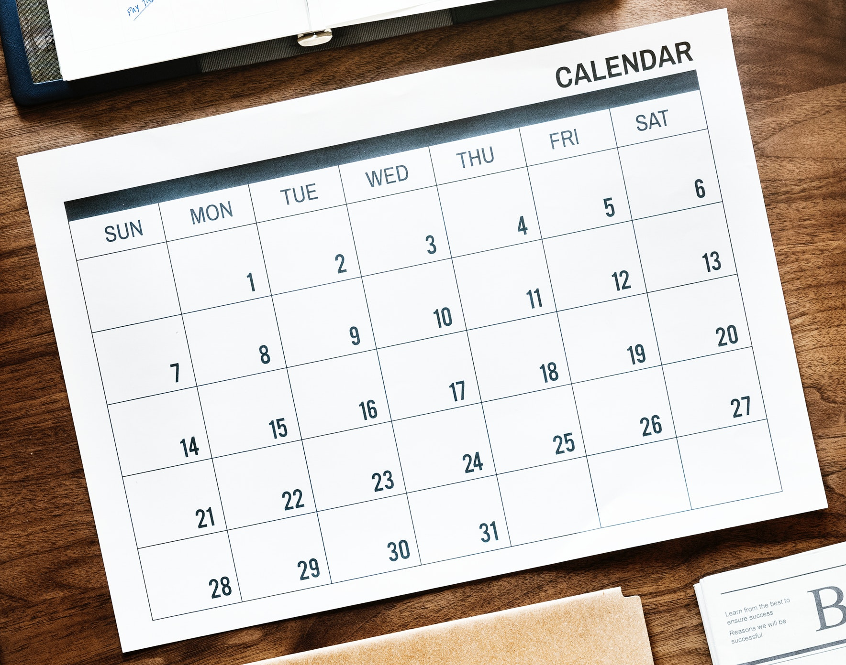
When Should You Backup?
It Depends…
How often does the data change?
How much work would be lost between backups?
What would it cost to replace the work?
How much work does it take to backup?

Slide 9
When Should You Backup?
Start a Backup Culture
Work as a team
Clearly define responsibilities
Have a regular Backup Day

Slide 10

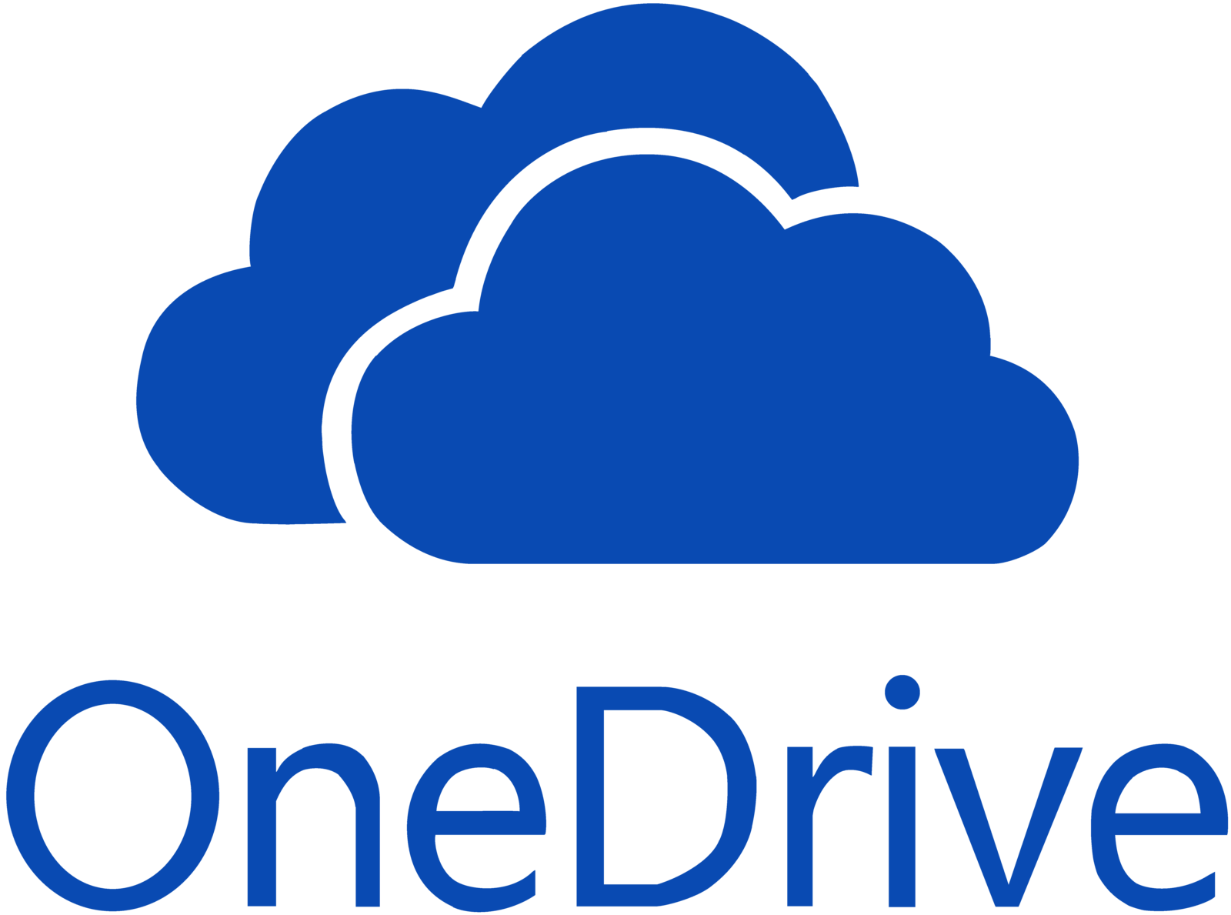


How Should You Backup?
Github
OSF
IRB, HIPPA sensitivity of data
TimeMachine Macs, Windows Backup, Rsync
Commercial Packages
Build cost into grants
Good DMPs (See DAVIS!)
And many others…

Slide 11
Case Studies
Who should backup?
What should be backed up?
Where should backups be done?
When should backups be done?
Why should backups be done?
How should backups be done?

Slide 12
Get help and learn more
Scheduled data workshops
https://libraries.ou.edu/events
Workshops on request
https://libraries.ou.edu/workshops-on-request
Carpentries workshops https://libraries.ou.edu/carpentries
Information Specialists https://libraries.ou.edu/davis
This slide deck available on our archive at https://osf.io/aw9y3/

Slide 13
Upcoming events!
More Love Data Week 2020
Feb 14, 11am-noon: Managing Research Projects with OSF
Feb. 20, 11am-2:30pm: Data in Plain Sight

Slide 14
Please take 3 min to help us improve
Survey link: https://ou.libwizard.com/f/datasurvey
Workshop topic: Survival Skills: Backups 101
Workshop date: February 11, 2020
Notes:
For those who didn’t bring a device, offer to email them via EventBrite

